Slide 1
Introduction
In this presentation, the kinematics of rigid bodies will be considered
The relations existing between the time, the positions, the velocities, and the accelerations of the various particles forming a rigid body are investigated

Slide 2
Types of Rigid-Body Motion
Translation
Rotation about a Fixed Axis
General Plane Motion
Motion about a Fixed Point
General Motion

Slide 3
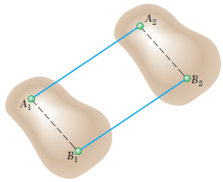
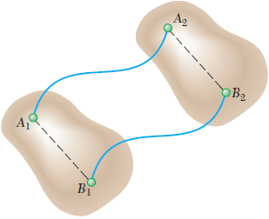
1. Translation
A motion is translation if any straight line inside the body keeps the same direction during the motion
All the particles forming the body move along parallel paths
If these paths are straight lines, the motion is said to be a rectilinear translation
If the paths are curved lines, the motion is a curvilinear translation
All the points of the body have the same velocity and the same acceleration at any given instant

Slide 4
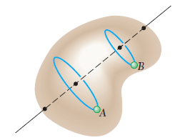
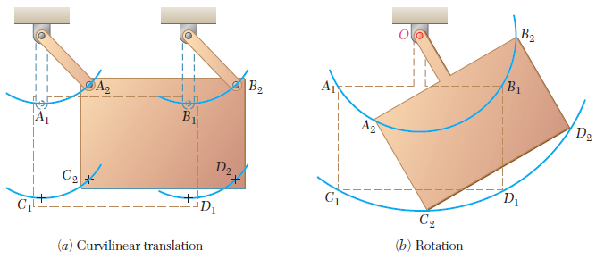
2. Rotation about a Fixed Axis
The particles forming the rigid body move in parallel planes along circles centered on the same fixed axis
If this axis, called the axis of rotation, intersects the rigid body, the particles located on the axis have zero velocity and zero acceleration

Slide 5
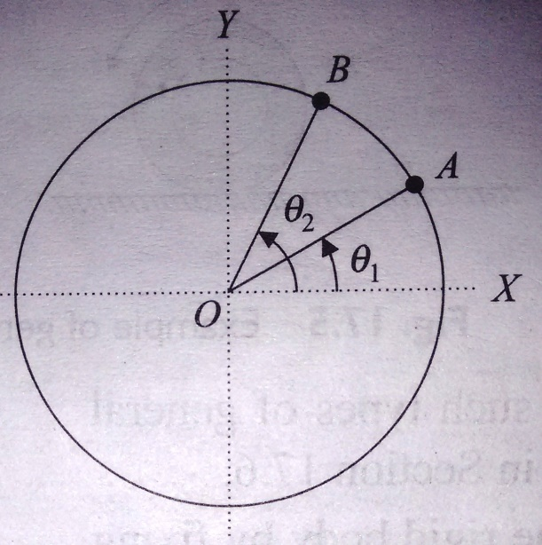
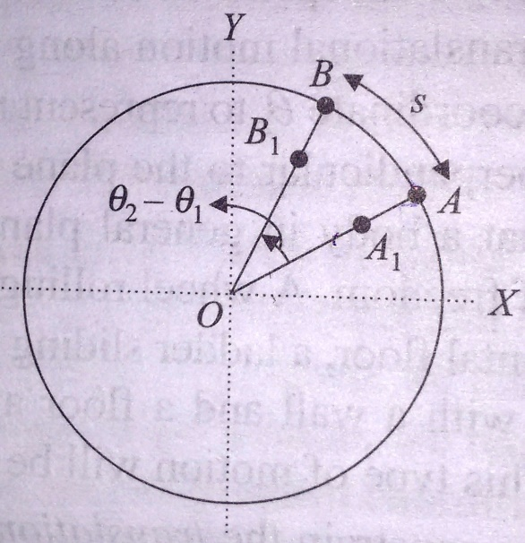
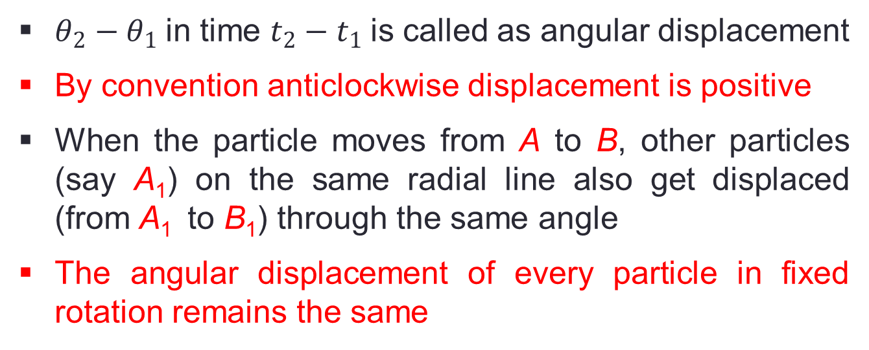
Angular Displacement
$θ_{2}−θ_{1}$in time $t_{2}−t_{1}$is called as angular displacement
By convention anticlockwise displacement is positive
When the particle moves from A to B, other particles (say A₁) on the same radial line also get displaced (from A₁ to B₁) through the same angle
The angular displacement of every particle in fixed rotation remains the same

Slide 6
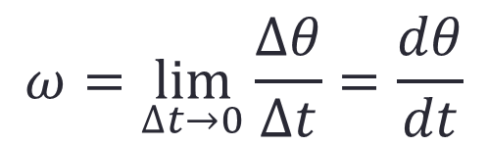
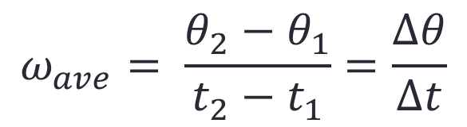
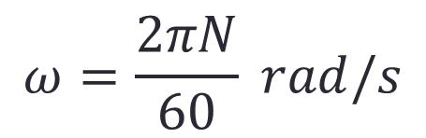
Angular Velocity
$$ω_{ave}= \frac{θ_{2}−θ_{1}}{t_{2}−t_{1}}=\frac{∆θ}{∆t}$$
$$ω=\lim_{∆t→0}{\frac{∆θ}{∆t}}=\frac{dθ}{dt}$$
$$ω=\frac{2πN}{60} rad/s$$
As we know that all the particles undergo same displacement in a given time interval, their angular velocity is also the same

Slide 7
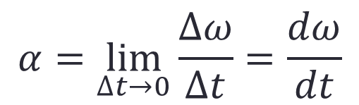
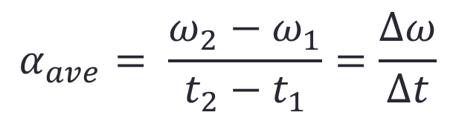
Angular Acceleration
$$α_{ave}= \frac{ω_{2}−ω_{1}}{t_{2}−t_{1}}=\frac{∆ω}{∆t}$$
$$α=\lim_{∆t→0}{\frac{∆ω}{∆t}}=\frac{dω}{dt}$$
Unit for angular acceleration is rad/s²
Angular acceleration is also same for all the particles in the rigid body
In fixed axis rotation, the angular displacement, velocity and acceleration are same for every particle in the body
Hence, by describing the motion of one particle in the body, the motion of the entire body can be described

Slide 8





Equations Defining the Rotation of a Rigid Body about a Fixed Axis
Uniform Rotation
Uniformly Accelerated Rotation

Slide 9

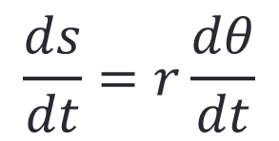
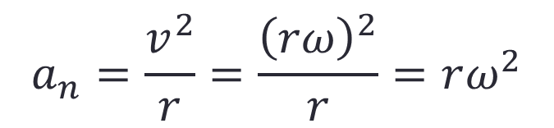


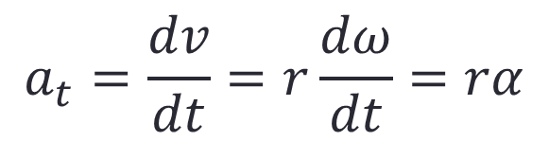

Relationship between Angular and Linear Motions
$$s=rθ$$
$$\frac{ds}{dt}=r\frac{dθ}{dt}$$
$$v=rω$$
$$a_{t}=\frac{dv}{dt}=r\frac{dω}{dt}=rα$$
Tangential acceleration,
$$a_{t}=rα$$
$$a_{n}=\frac{v^{2}}{r}=\frac{{\left(rω\right)}^{2}}{r}=rω^{2}$$
Normal acceleration,
$$a_{n}=rω^{2}$$

Slide 10
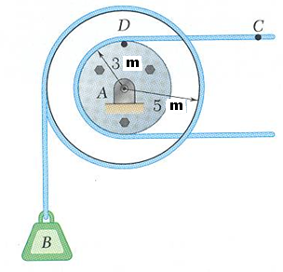
Problem 1
Cable C has a constant acceleration of 9 m/s² and an initial velocity of 12 m/s, both directed to the right. Determine (a) the number of revolutions of the pulley in 2 s, (b) the velocity and change in position of the load B after 2 s, and (c) the acceleration of the point D on the rim of the inner pulley at t = 0.

Slide 11
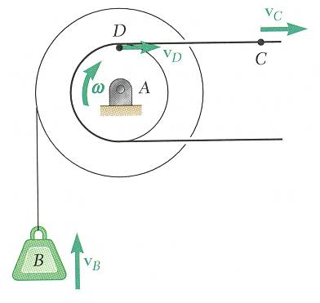








Solution
The tangential velocity and acceleration of D are equal to the velocity and acceleration of C.
a. Motion of Pulley
$${\left(v_{D}\right)}_{0}={\left(v_{C}\right)}_{0}=12 m/s$$
$${\left(a_{D}\right)}_{t}=a_{C}=9 m/s^{2}$$
$${\left(v_{D}\right)}_{0}=rω_{0}$$
$$12=3ω_{0}$$
$$ω_{0}=4 rad/s$$
$${\left(a_{D}\right)}_{t}=rα$$
$$9=3α$$
$$α=3 rad/s^{2}$$

Slide 12



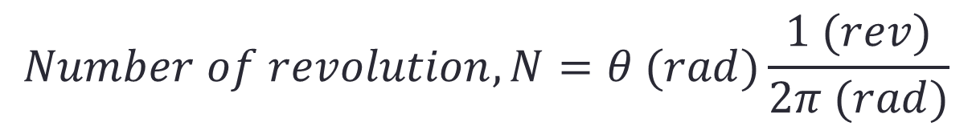

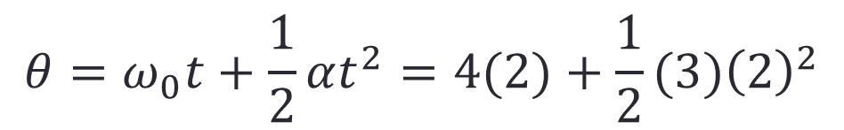
Using the equations of uniformly accelerated motion, we obtain, for t = 2 s,
$$ω=ω_{0}+αt=4+3(2)$$
$$ω=10 rad/s$$
$$θ=ω_{0}t+\frac{1}{2}αt^{2}=4(2)+\frac{1}{2}(3){\left(2\right)}^{2}$$
$$θ=14 rad$$
$$Number of revolution,N=θ (rad)\frac{1 (rev)}{2π (rad)}$$
$$N=2.23 rev$$

Slide 13
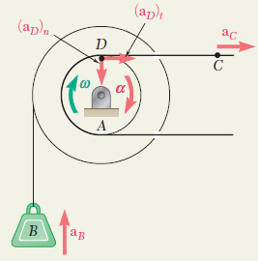




b. Motion of Load B
$$v_{B}=rω=5\left(10\right)$$
$$v_{B}=50 m/s$$
Displacement of B in y-direction,
$$y_{B}=rθ=5\left(14\right)$$
$$y_{B}=70 m (upward)$$

Slide 14
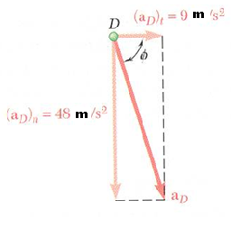


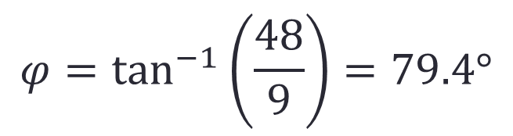


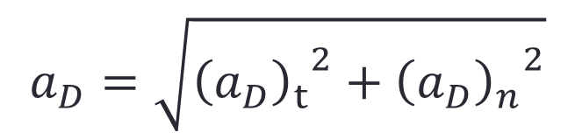
c. Acceleration of Point D at t = 0
$${\left(a_{D}\right)}_{n}=r_{D}{ω_{0}}^{2}=3{\left(4\right)}^{2} m/s^{2}$$
$${\left(a_{D}\right)}_{n}=48 m/s^{2}↓$$
$$a_{D}=\sqrt{{{\left(a_{D}\right)}_{t}}^{2}+{{\left(a_{D}\right)}_{n}}^{2}}$$
$$a_{D}=48.83 m/s^{2}$$
$$φ=\tan^{−1}\left(\frac{48}{9}\right)=79.4°$$
$$φ=79.4°$$

Slide 15
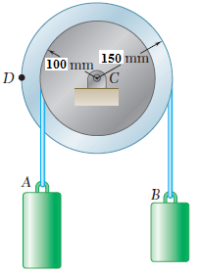
Problem 2
A pulley and two loads are connected by inextensible cords as shown figure. The pulley starts from rest at t = 0 and is accelerated at the uniform rate of 2.5 rad/s² clockwise. At t = 5 s, determine the velocity and position of load A and load B.

Slide 16
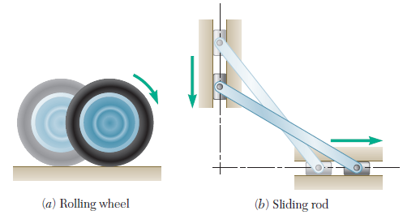
3. General Plane Motion
Motions in which all the particles of the body move in parallel planes
Any plane motion which is neither a rotation nor a translation is referred to as a general plane motion

Slide 17
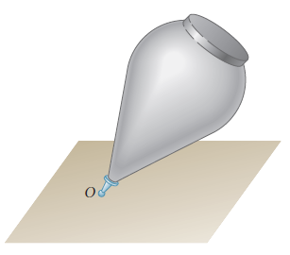
4. Motion about a Fixed Point
The three-dimensional motion of a rigid body attached at a fixed point O, e.g., the motion of a top on a rough floor, is known as motion about a fixed point

Slide 18
5. General Motion
Any motion of a rigid body which does not fall in any of the categories above is referred to as a general motion

Slide 19
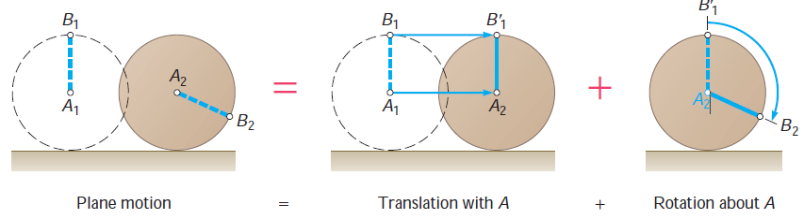
General Plane Motion
A plane motion which is neither a rotation nor a translation
However, a general plane motion can always be considered as the sum of a translation and a rotation

Slide 20
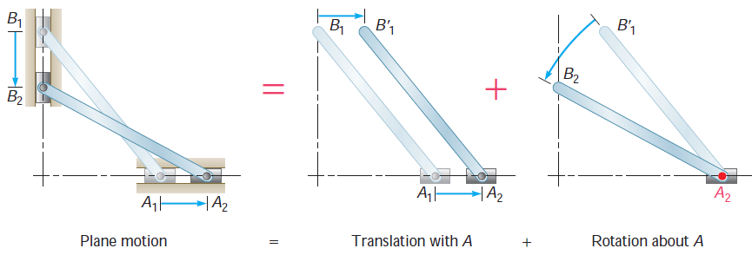
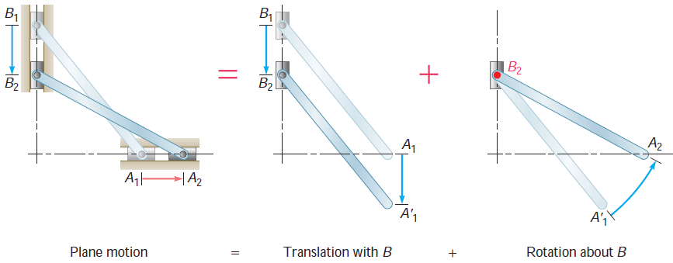

Slide 21
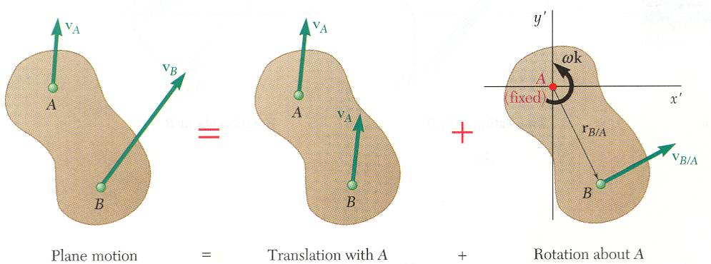
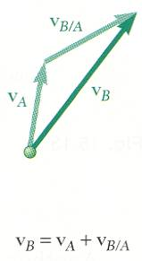
Absolute and Relative Velocity in Plane Motion
Any plane motion can be replaced by a translation of an arbitrary reference point A and a simultaneous rotation about A.

Slide 22
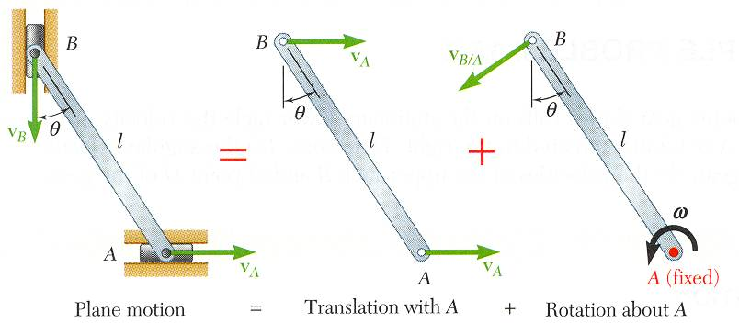
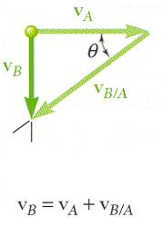
Assuming that the velocity v_{A} of end A is known, wish to determine the velocity v_{B} of end B and the angular velocity w in terms of v_{A}, l, and q.
The direction of v_{B} and v_{B/A} are known. Complete the velocity diagram.

Slide 23
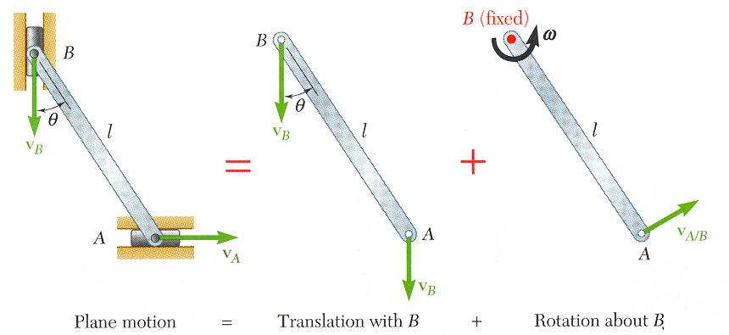
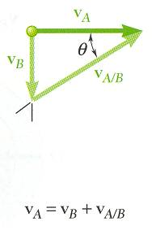
Selecting point B as the reference point and solving for the velocity v_{A} of end A and the angular velocity w leads to an equivalent velocity triangle.
v_{A/B} has the same magnitude but opposite sense of v_{B/A}. The sense of the relative velocity is dependent on the choice of reference point.
Angular velocity w of the rod in its rotation about B is the same as its rotation about A. Angular velocity is not dependent on the choice of reference point.

Slide 24
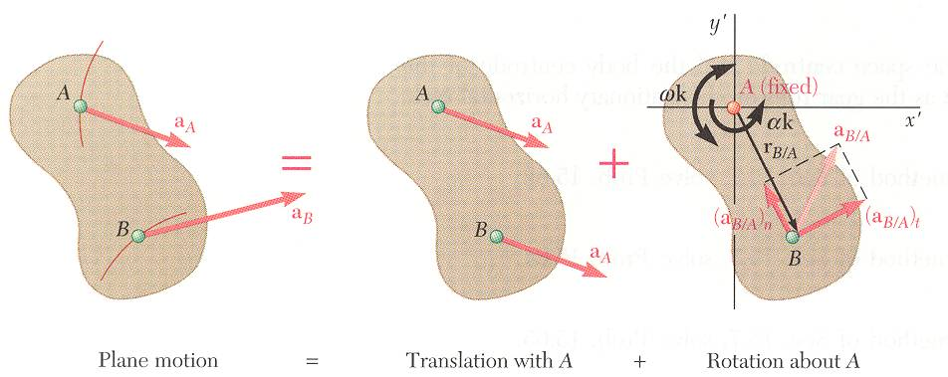
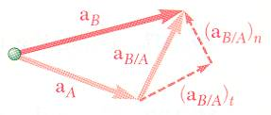
Absolute and Relative Acceleration in Plane Motion
Absolute acceleration of a particle of the slab,
Relative acceleration associated with rotation about A includes tangential and normal components,

Slide 25
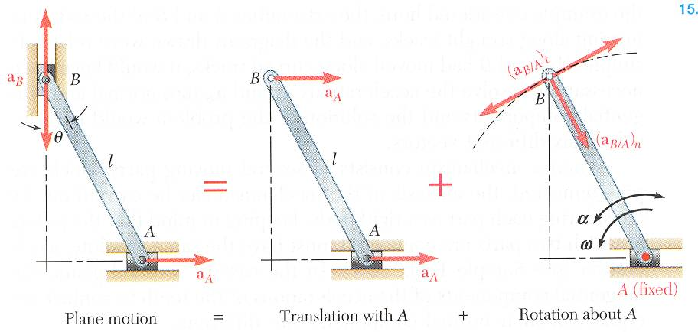
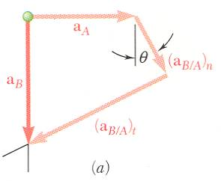
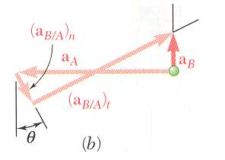
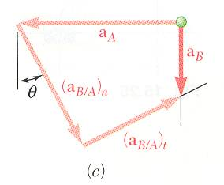
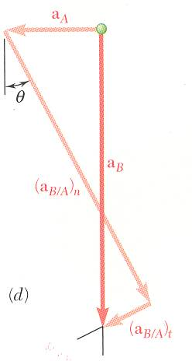
Given determine
Vector result depends on sense of and the relative magnitudes of
Must also know angular velocity ω.

Slide 26
Absolute and Relative Acceleration in Plane Motion
Write in terms of the two component equations,
x components:
y components:
Solve for a_{B} and α.

Slide 27
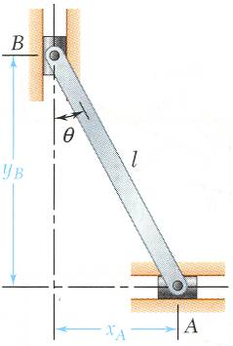
Analysis of Plane Motion in Terms of a Parameter
In some cases, it is advantageous to determine the absolute velocity and acceleration of a mechanism directly.

